Slide 1
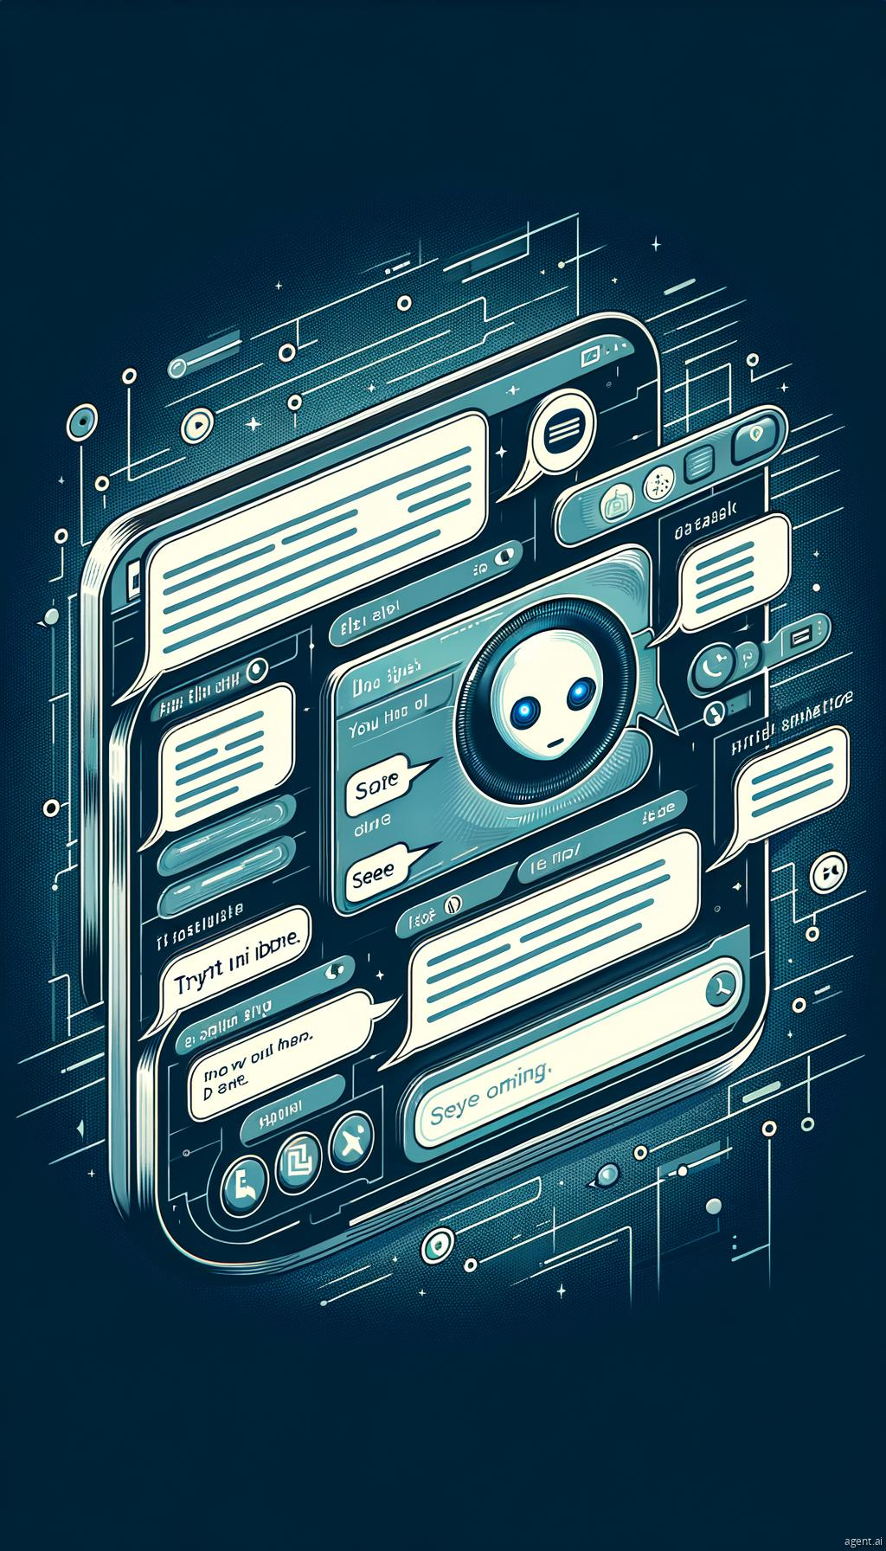
Chatbot Application
A Java-based Chatbot Overview

Slide 2
Structure of the Code
Main Components: Imports and Class Declaration, Class Name: ChatbotApp

Slide 3
Data Structures
Stores user information using ArrayLists and Maps for predefined responses.

Slide 4
Entity Answers
Maps questions to answers using a HashMap for quick retrieval.

Slide 5
Main Method
Handles user interaction, allowing for chat history and keyword search.

Slide 6
Chat Functionality
Processes user input for commands like 'bye', 'history', and 'search <word>'.

Slide 7
Generating Responses
Checks for specific phrases and retrieves user information.

Slide 8
User Management
Creates or retrieves users based on their ID.

Slide 9
Additional Features
Tracks user interests and majors, responding to queries about preferences.

Slide 10
Conclusion
Interactive chatbot with memory capabilities, engaging users with personalized responses.

